Slide 1



JASMINE
TESTING
FRAMEWORK
Unit Testing Using JavaScript

Slide 2



GROUP MEMBERS
Aqsa
Asiya Gul
Areej Zeb
Mahnoor Fazal

Slide 3
OVERVIEW
Role of automated testing in software development
Introduction to Jasmine framework
Benefits of using Jasmine
Versions of Jasmine
When/Why to opt for?
Basic concepts and features of Jasmine framework
Common Matchers
Setup and teardown
Skip Spec
Spies in Jasmine
Asynchronous Testing
Set up and configuration
Illustrate test cases for different functions
Conclusion

Slide 4
ROLE OF AUTOMATED TESTING IN SOFTWARE DEVELOPMENT
Automated testing is essential in software development for its efficiency and accuracy in executing test cases quickly and repeatedly. It supports continuous integration and deployment (CI/CD) processes, ensuring that new code changes do not introduce bugs. By eliminating human error and providing extensive coverage, automated testing significantly enhances software quality and development speed.

Slide 5
KEY FEATURES OF AUTOMATED TESTING
Efficiency and Speed
Support for CI/CD
Elimination of Human Error
Extensive Coverage
Enhanced Software Quality
Faster Development Cycles

Slide 6
INTRODUCTION
Jasmine is a behavior-driven development (BDD) framework for testing JavaScript code. It provides an easy-to-read syntax for writing tests and supports both synchronous and asynchronous testing. Jasmine is independent of other JavaScript frameworks, making it versatile and straightforward to integrate into various projects.

Slide 7

BENEFITS OF USING JASMINE
Strong Documentation
And Integration
With Other Tools
Comprehensive
Feature Set
Readable And
Expressive Syntax
Independence From
Other Framework
Encourages Good
Testing Practices

Slide 8
VERSIONS OF JASMINE
Jasmine Standalone Version:
Ideal for quick setup and browser-based testing without dependencies.
Jasmine Core (jasmine-core):
Provides essential libraries for custom integrations.
Jasmine Node Version:
Designed for server-side testing in Node.js environments.
Jasmine Browser Runner:
Facilitates running tests in actual browser environments.
Jasmine Karma:
Enables running tests across multiple browsers with continuous integration.
Jasmine Jest:
Extends Jasmine for broader features and easier configuration.
Jasmine Enzyme:
Specialized for testing React components alongside Jasmine.

Slide 9

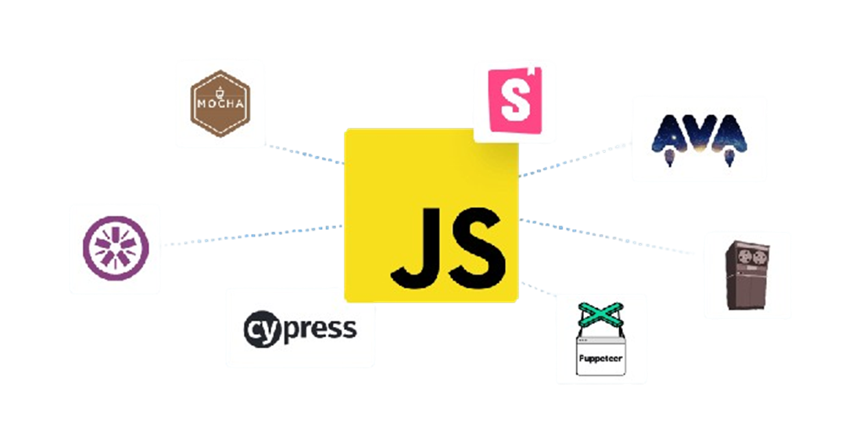
TOOLS OTHER THEN JASMINE
Mocha
Jest
QUnit
AVA
Cypress
Jasmine-Node
Protractor
Chai

Slide 10
WHEN/WHY OPT IT?
Easy to implement, install, and understand.
Provides good documentation.
Angular officially supports the jasmine which is the main reason to use it.
Jasmine is suitable for testing JavaScript code in a browser or Node.js environment, providing a clean syntax for behavior-driven development. However, it might not be the best choice for projects requiring extensive integration testing or when working with legacy codebases that lack modular design, where tools like Selenium or Cypress might be more suitable for end-to-end testing due to their capabilities for interacting with web pages and simulating user behavior.

Slide 11
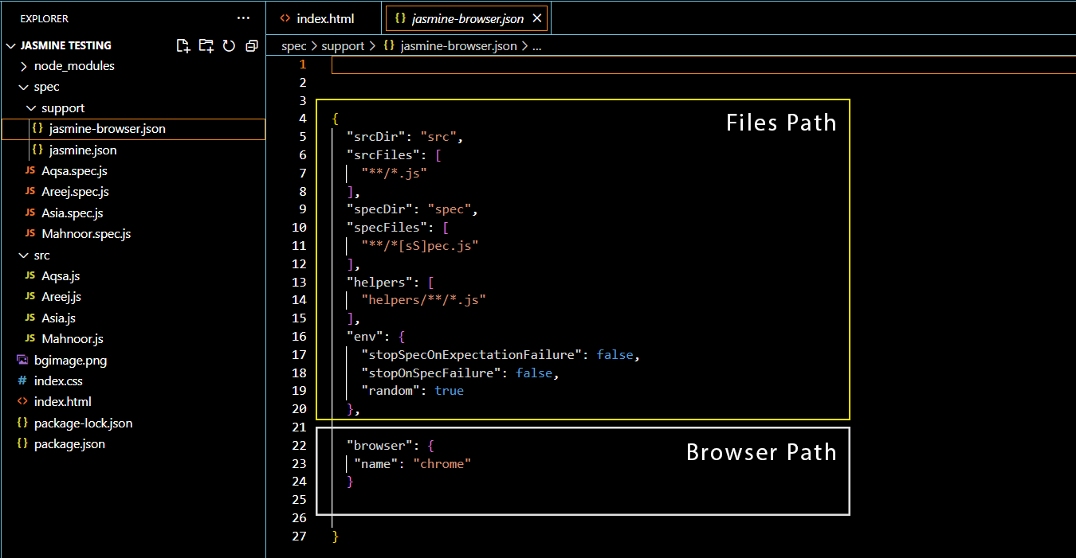
MAIN FEATURES AND CONCEPTS
Here, are some basic concepts that you need to understand in order to create successful test cases in the Jasmine framework.
There will be a folder named “Support” Inside the support folder there is a file named “Jasmine-Browser.Json” that contains various directories of files. Additionally, a browser directory is provided, which defaults to Firefox, but you can change it to your preferred browser.

Slide 12
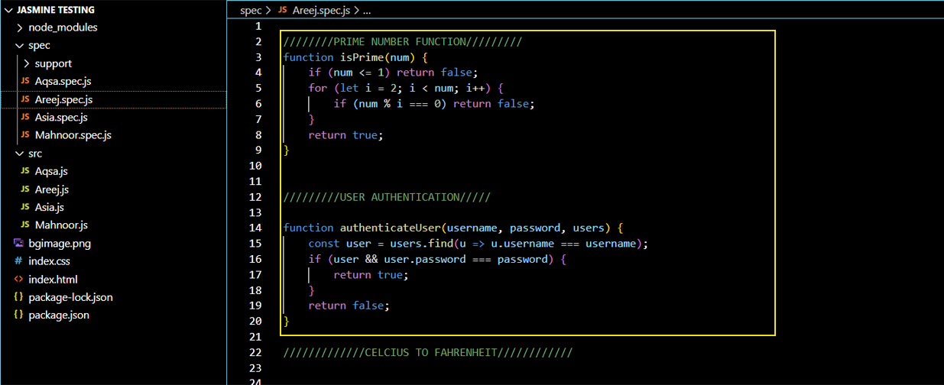
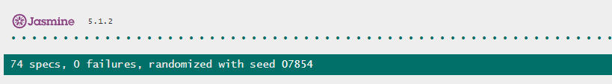
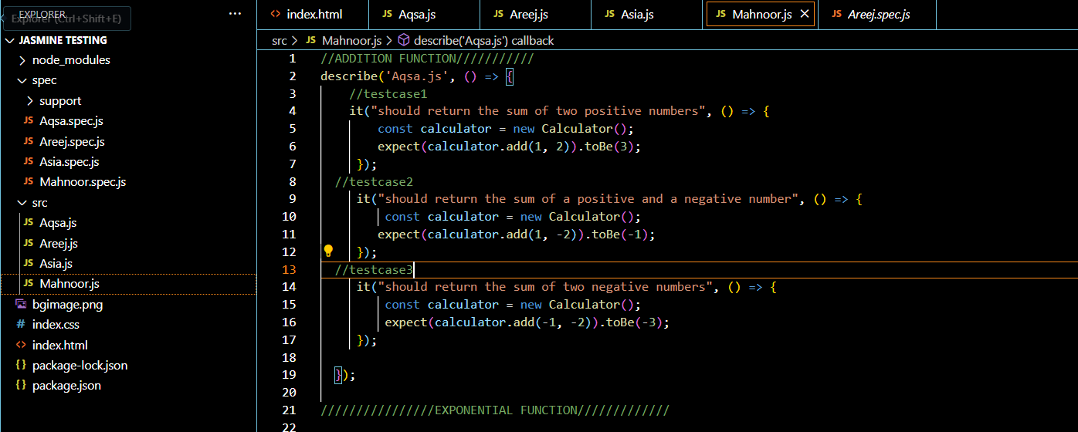
MAIN FEATURES AND CONCEPTS
2. “Spec Folder” contains the specs files where test cases will be generated. There can be multiple Specs files.
3. There is a “Src Folder” in which test functions will be created and there can be multiple src files.
4. “Seed value” just controls the order in which tests will be executed. It is basically similar to token generated during testcases.

Slide 13
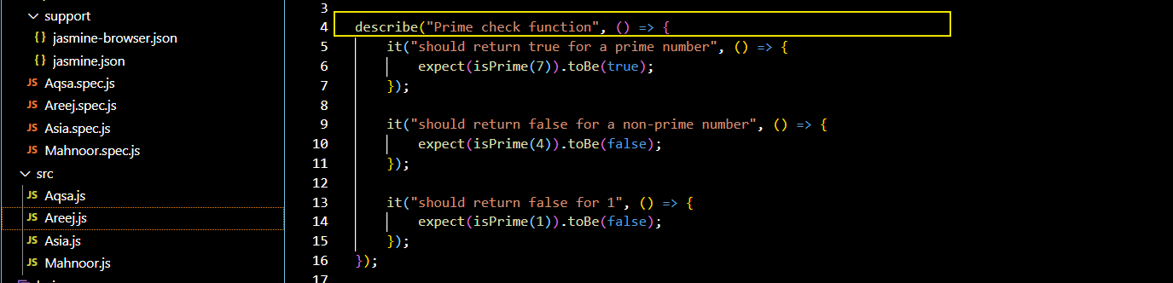
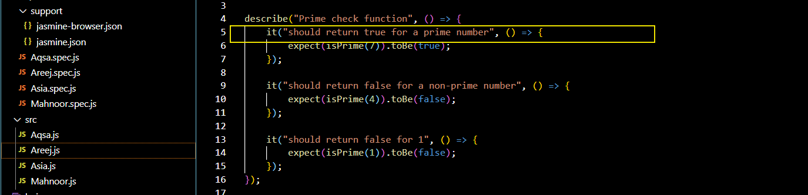
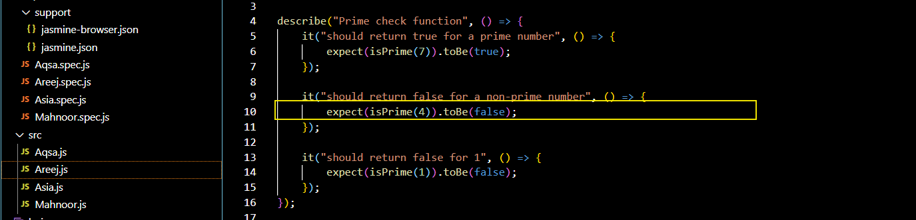
MAIN FEATURES AND CONCEPTS
5. The function with the "describe" keyword is used to define a test suite, within which multiple test cases can be written.
6. “It” defines individual test cases.
7. “expect” and matchers like “toBe” and “toContain” are used to assert the expected outcomes. The following slide will discuss some of the common matchers that we frequently use.

Slide 14
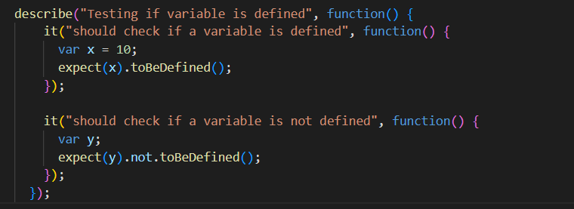
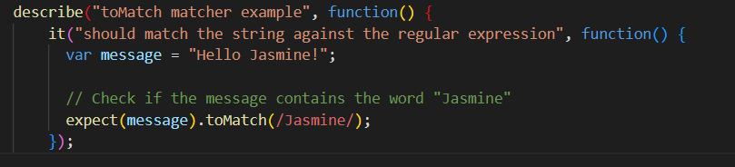
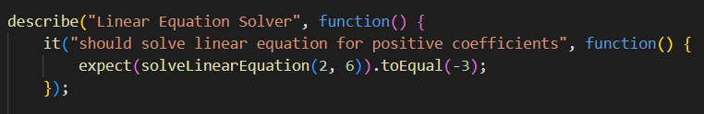
COMMON MATCHERS
Matchers are functions that are chained onto ‘expect’ calls to specify what you expect your code to do.
Compare the actual result of your code with an expected result.
Common matcher
toBe: Checks if two values are the same using equal
toEqual: Checks if two objects are equivalent
toMatch: Checks if a string matches a regular expression.
toBeDefined: Checks if a variable is defined
toBeUndefined: Checks if a variable is undefined

Slide 15
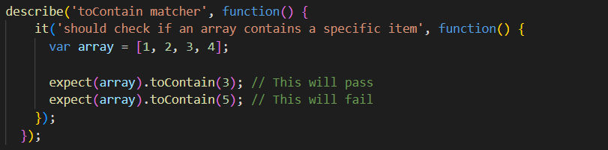
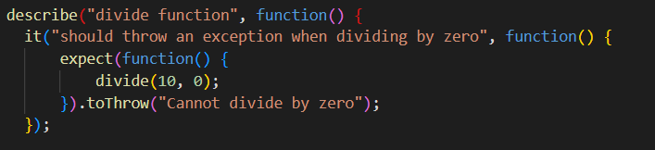
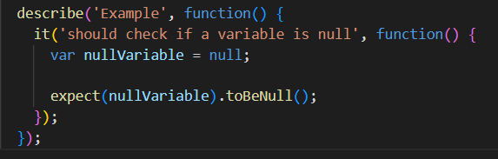
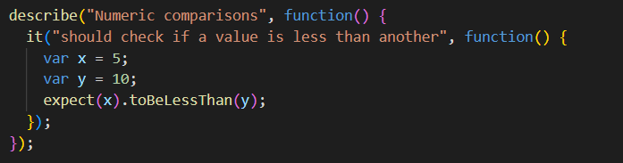
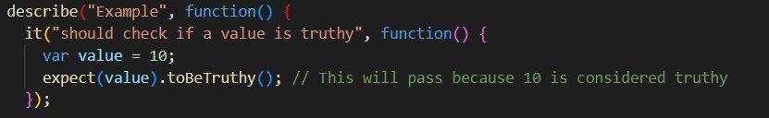
COMMON MATCHERS
toBeTruthy: Checks if a value is truthy
toBeFalsy: Checks if a value is falsy
toBeNull: Checks if a variable is null
toContain: Checks if an array contains a specific item
toBeLessThan: Checks if a value is less than another
toBeGreaterThan: Checks if a value is greater than another
toThrow: Checks if a function throws an exception

Slide 16
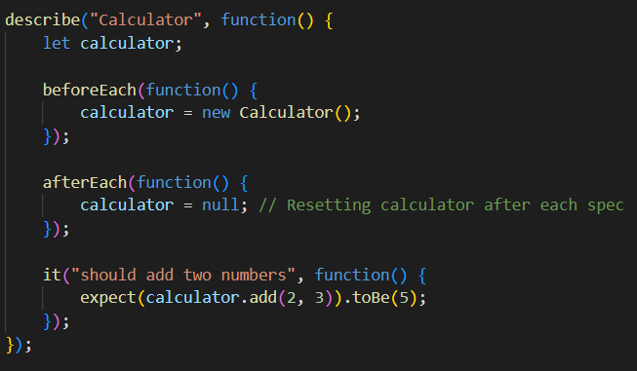
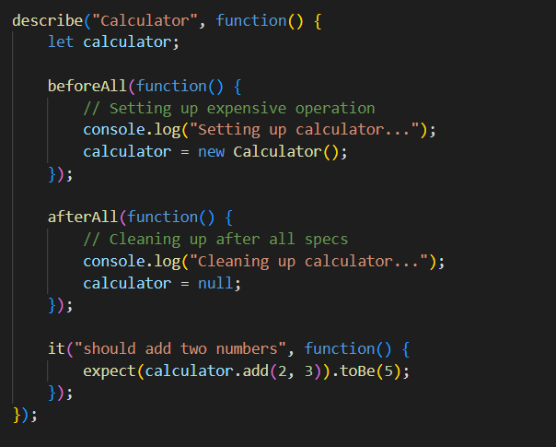
SETUP AND TEARDOWN
Jasmine provides functions ‘beforeEach’, ‘afterEach’,’beforeAll’, and ‘afterAll‘ to set up and tear down
test environments.
Setup and Teardown:
“beforeEach” Runs before each test (spec) in a “describe” block.
“afterEach”: Runs after each test (spec) in a “describe” block.
“beforeAll”: Runs once before all the tests in a “describe” block.
“afterAll”: Runs once after all the tests in a “describe” block.

Slide 17
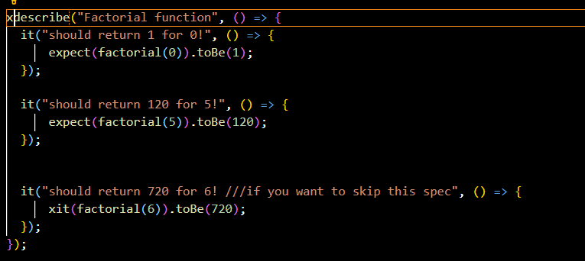
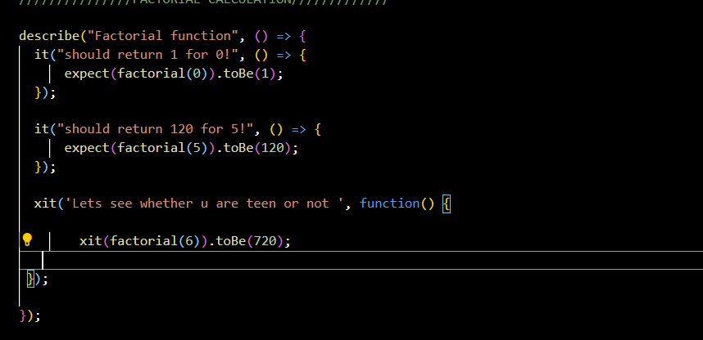
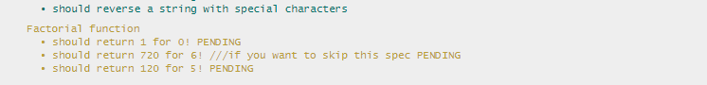
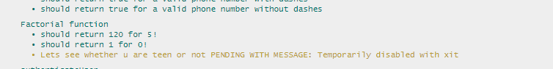
SKIP SPEC
Use to skip a spec xit() function is used to skip the spec the structure will look like this
Similarly you can skip the entire test suite using xdescribe() function

Slide 18
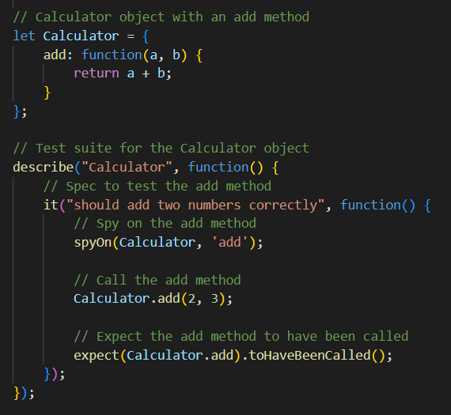
SPIES IN JASMINE
Spies are a feature used for mocking, tracking and verifying to observe the behavior of functions during testing. Using spies in Jasmine enhances the testing process by providing tools to monitor, control, and verify the behavior of functions.
This results in more effective, reliable, and maintainable tests. Spies allow you to focus on testing the logic of your code without worrying about the behavior of its dependencies, leading to better isolation and more robust unit tests.
They allow you to spy on function calls and determine how many times they were called, with what arguments, etc.
Jasmine provides functions like jasmine.createSpy, spyOn, toHaveBeenCalled, toHaveBeenCalledWith, etc., for creating and using spies.

Slide 19
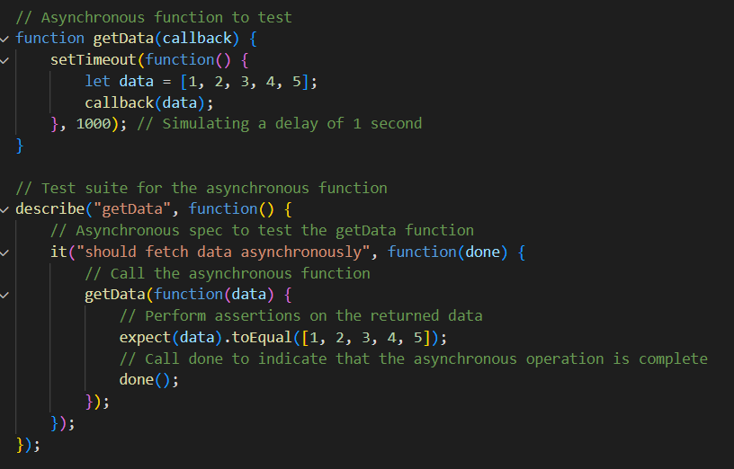
ASYNCHRONOUS TESTING
Jasmine supports testing asynchronous code using callbacks, Promises, or async/await syntax.
Handles real-world scenarios.
It provides mechanisms like done callback, returning a Promise from a spec, or using async/await
keywords to handle asynchronous operations in tests.
Jasmine knows to wait until the done callback is called before considering the spec complete.

Slide 20
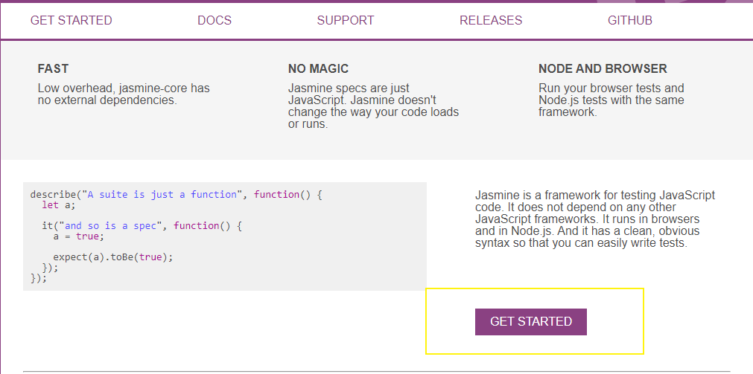
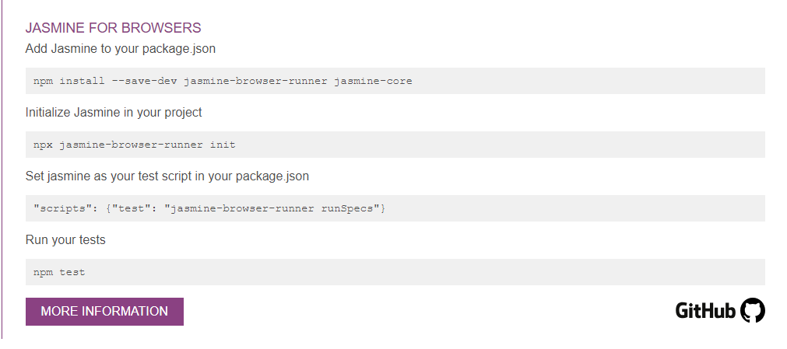
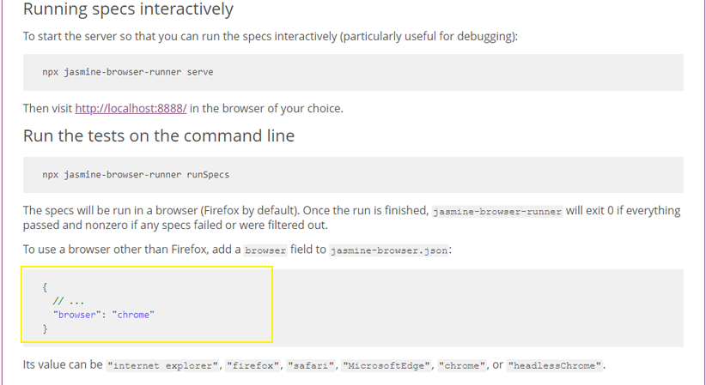
SETTINGUP THE DEVELOPMENT ENVIRONMENT
INSTALLATION STEPS:
Please establish a folder within a preferred drive to initiate the project setup.
Open a command prompt in the newly created folder to proceed with the installation steps provided in the following link.
Please access the provided link, https://jasmine.github.io/ for detailed instructions on installation.

Slide 21
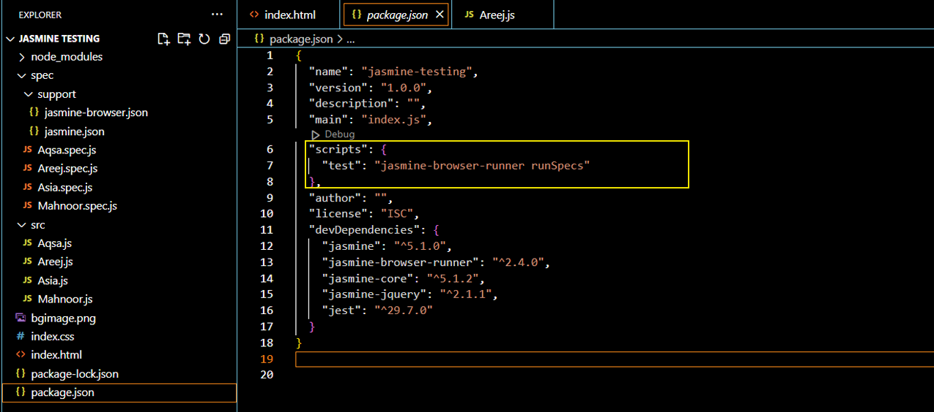
SETTINGUP THE DEVELOPMENT ENVIRONMENT
4. To open the code editor (Visual Studio Code) type command “code .” in command prompt.
5. To enable test execution, please insert the following command into the "Package.json" file within the integrated development environment (IDE): "scripts": {"test": "jasmine-browser-runner runSpecs"}.

Slide 22
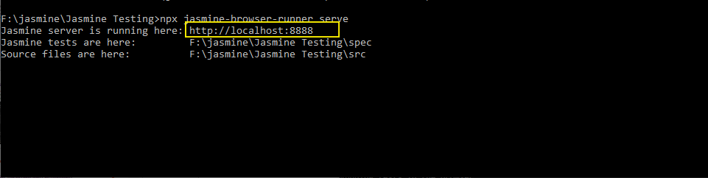
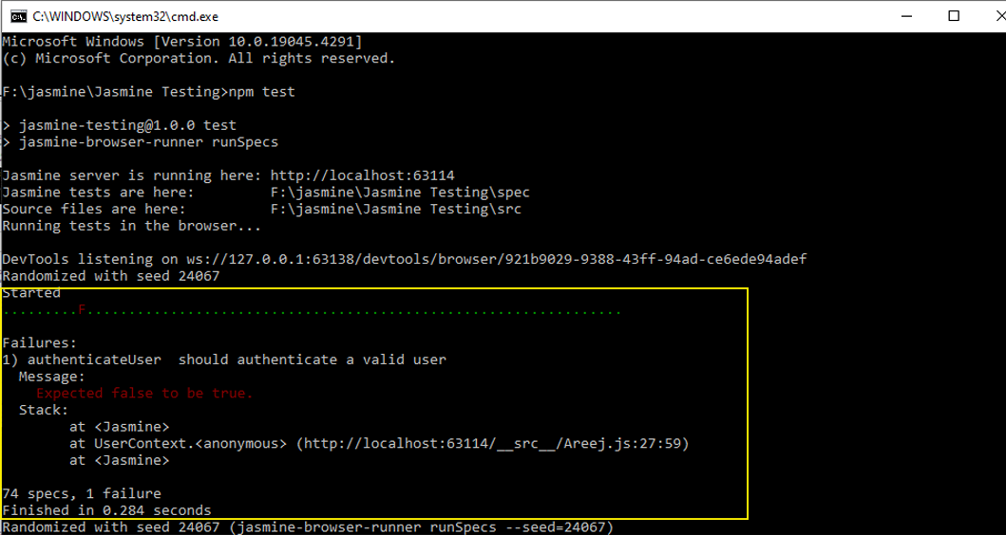
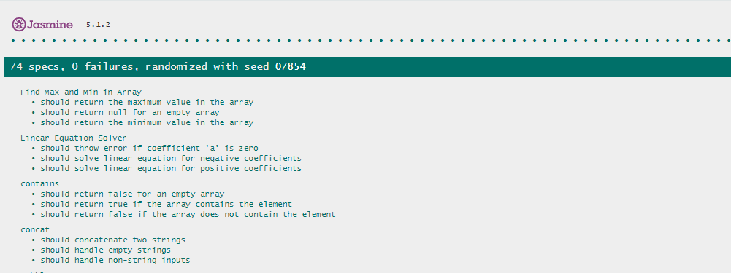
SETTINGUP THE DEVELOPMENT ENVIRONMENT
6. Finally, to run the test cases within the browser execute command.” npm test”
7. To open the test cases in the browser use the given command in cmd. “npx jasmine-browser-runner serve”

Slide 23
TEST CASE WITH DIFFERENT FUNCTIONS
MATHEMATICAL OPERATIONS | Testing add function Testing linear equation function Testing exponential function Testing Factorial Function Testing a Function that Checks a Prime number Testing Celsius to Fahrenheit function
STRING OPERATIONS | Testing String Concatenation Function Testing string reversal function Testing a Function that Capitalizes the First Letter of Each Word Testing function to remove white spaces from a string
ARRAY OPERATIONS: | Testing function to check particular element in an array Testing max and min in an array function Testing a Function that Removes the Duplicates from an Array Testing a Function that Counts the Occurrences of Each Element in an Array
DATA STRUCTURE AND ALGORITHMIC OPERATIONS: | Testing function to check an object has a particular property or not Testing bubble sort algorithm function Testing function to inserting a number in a stack
VALIDATION OPERATIONS: | Testing function that Validates Emails Testing User Authentication function Testing function to validate a phone number

Slide 24

CONCLUSION
By mastering Jasmine, you can write reliable, maintainable, and understandable tests for your JavaScript code. This improves code quality, facilitates refactoring, and ensures that your application behaves correctly as it evolves.
Regularly running and maintaining your test suite is crucial for continuous integration and deployment workflows. Jasmine equips you with the tools to build robust test suites, enhancing your development process and contributing to the overall stability and quality of your projects.

Slide 25
QUESTIONS
What are the three key elements for creating the test suite?
Answer:
The function with the "describe" keyword is used to define a test suite, within which multiple test cases can be written.
“It” defines individual test cases.
“expect” and matchers like “toBe” and “toContain” are used to assert the expected outcomes.
What is Asynchronous testing?
Jasmine supports testing asynchronous code using callbacks, Promises, or async/await syntax.
Handles real-world scenarios.
It provides mechanisms like done callback, returning a Promise from a spec, or using async/await
keywords to handle asynchronous operations in tests.
Jasmine knows to wait until the done callback is called before considering the spec complete.

Slide 26
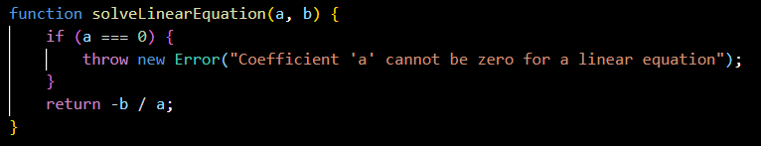
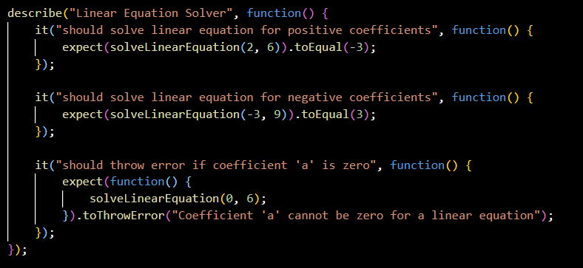
QUESTIONS
3. Give an example of a function along with its test suite?

Slide 27


Thank you !

